Slide 1
printer
A printer is a device that accepts text and graphic output from a computer and transfers the information to paper, usually to standard size sheets of paper.
Printers vary in size, speed, sophistication, and cost.
In general, more expensive printers are used for higher-resolution color printing.

Slide 2
Types of printers
There are two types of printers:
1. Impact Printers
2. Non-impact Printers

Slide 3
Impact Printers
An impact printer makes contact with the paper. It usually forms the print image by pressing an inked ribbon against the paper using a hammer or pins. Following are some examples of impact printers dot-matrix printer, daisy-wheel printer, Line printers, drum printer, chain printer, band printer.

Slide 4
Non-impact Printers
Non-impact printers do not use a striking device to produce characters on the paper; and because these printers do not hammer against the paper they are much quieter. Following are some non-impacted printers Ink-jet printers and laser printer.

Slide 5
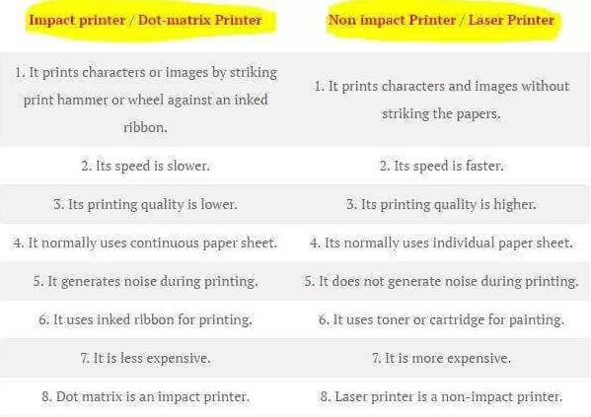
Impact vs Non-impact Printers

Slide 6
Classification of Printer
Printer classification based on their technology. Typical printer types are: 1. Dot matrix printer 2. Ink-jet printer 3. Laser printer

Slide 7
Dot Matrix Printer
A dot matrix printer or impact matrix printer refers to a type of computer printer with a print head that runs back and forth on the page and prints by impact, striking an ink-soaked cloth ribbon against the paper, much like a typewriter. Dot-matrix technology uses a series or matrix of pins to create printed dots arranged to form characters on a piece of paper. Because the printing involves mechanical pressure, these printers can create carbon copies and carbonless copies. The print head mechanism pushes each pin into the ribbon, which then strikes the paper.

Slide 8
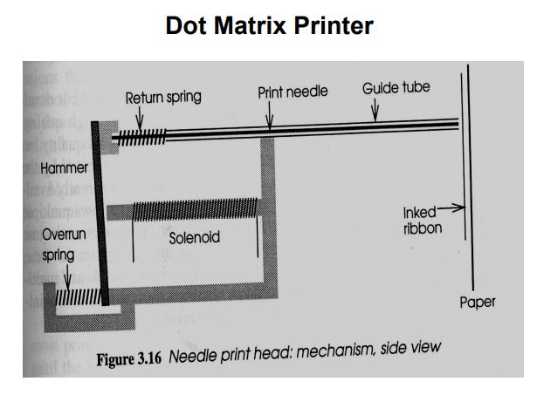
Dot Matrix Printer

Slide 9
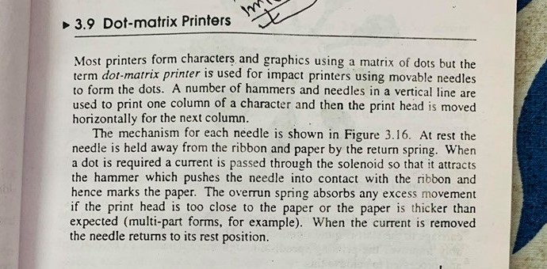
…….

Slide 10
Dot Matrix Printer
Advantages: 1.They can print on multi-part stationary or make carbon copies 2. Low printing cost 3. They can bear environmental conditions. 4. Long life
Disadvantage 1. Noise 2. Low resolution 3. Very limiter Color performance 4. Low speed

